Slide 1
Structuring Industrial Security Standards for Machine-Readable Analysis
Dipan Banerjee
Notes:
1

Slide 2
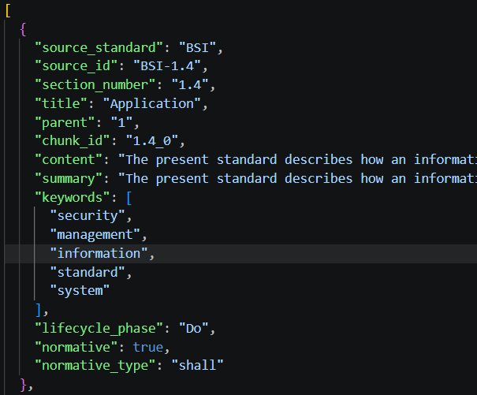
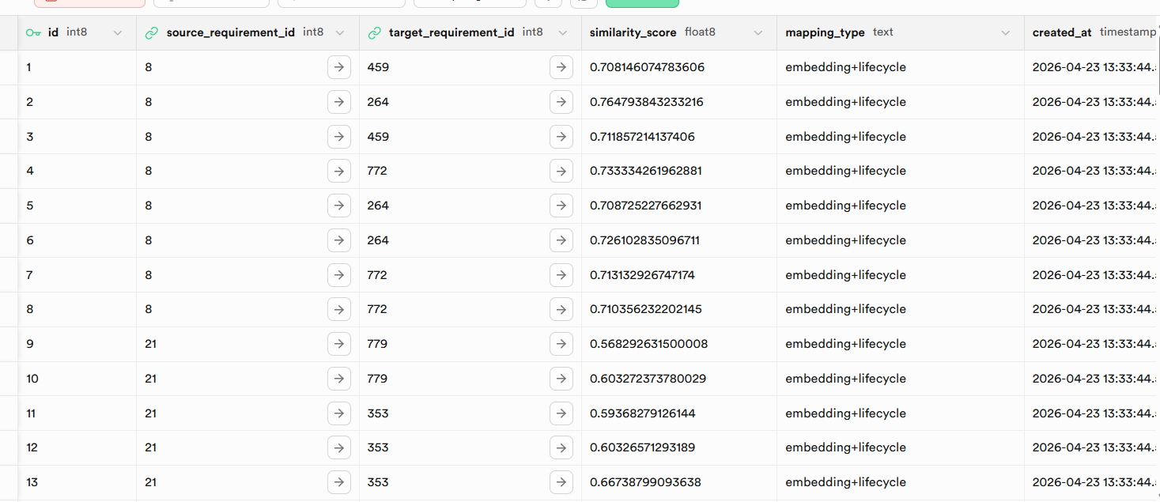
Recap -Database Now
2
Notes:
2

Slide 3
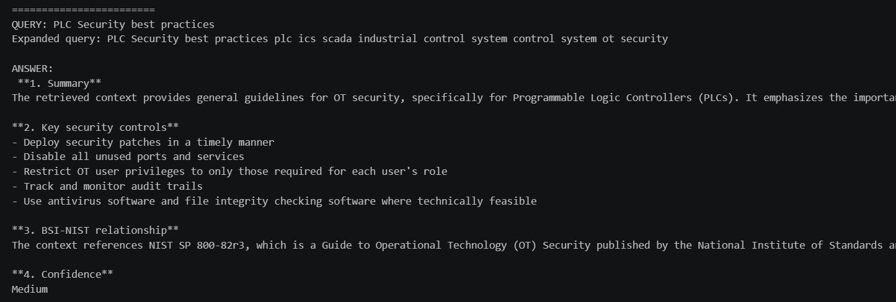
Recap-Results
3
07.11.2019
Notes:
3

Slide 4
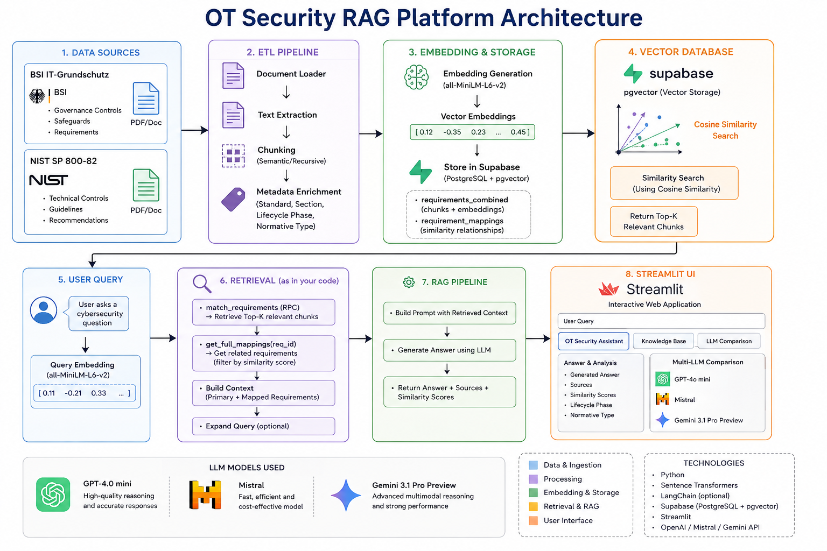
Overall System Architecture
4
Notes:
4

Slide 5
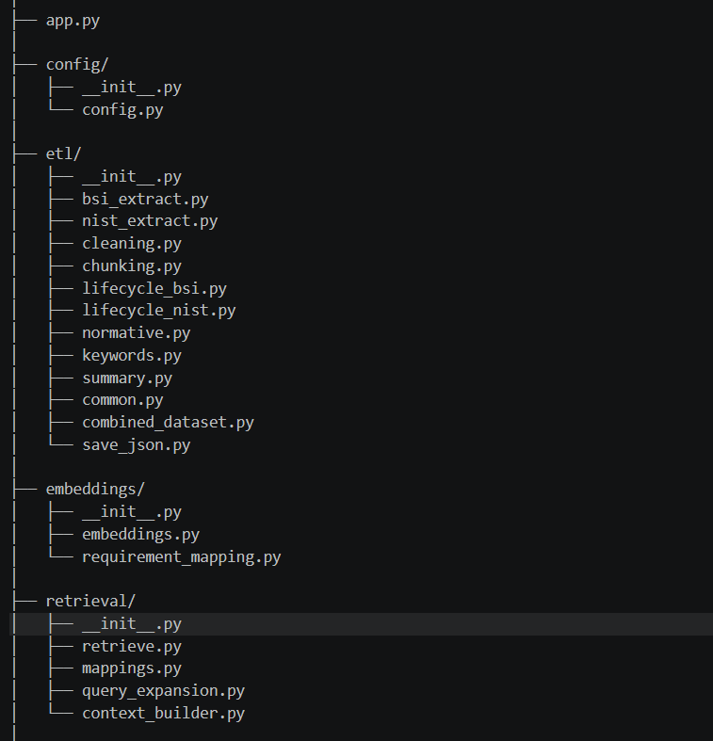
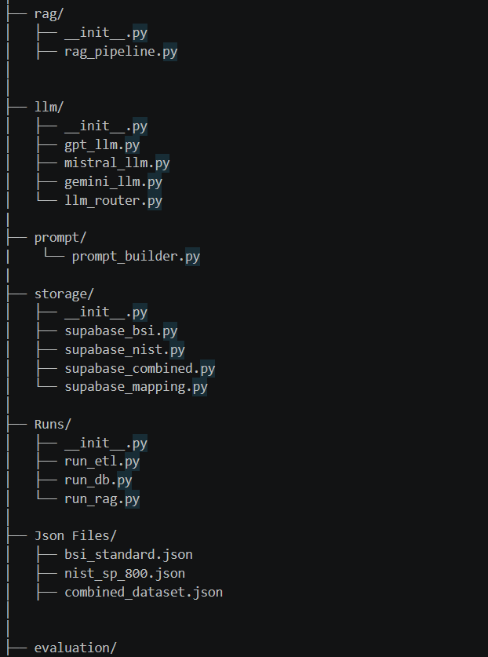
Backend Modular Coding
5
Notes:
5

Slide 6
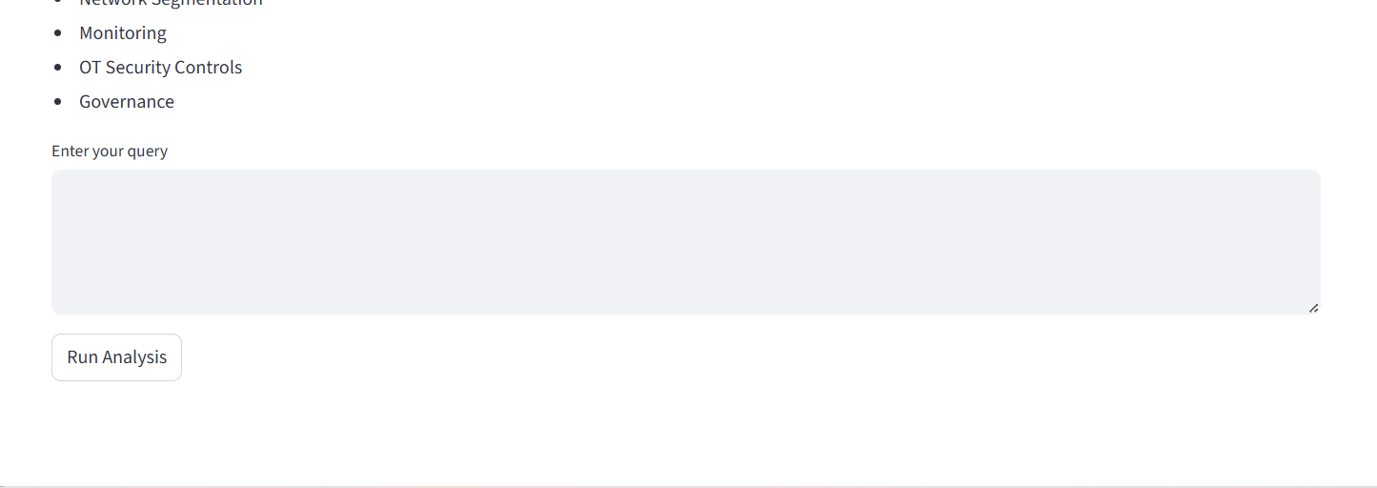
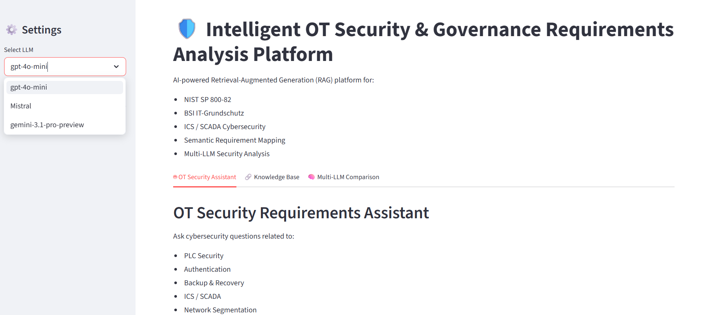
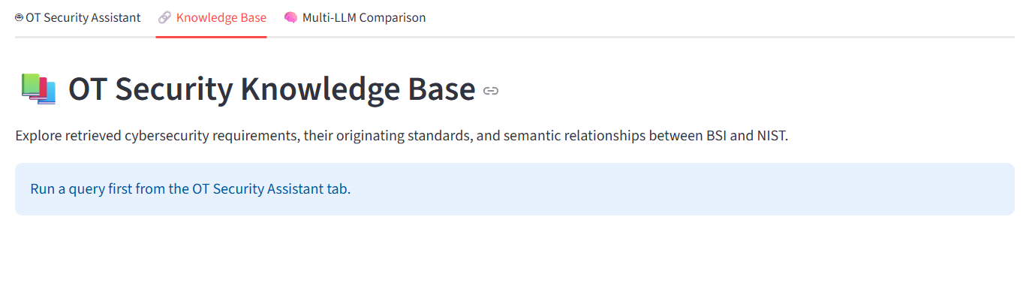
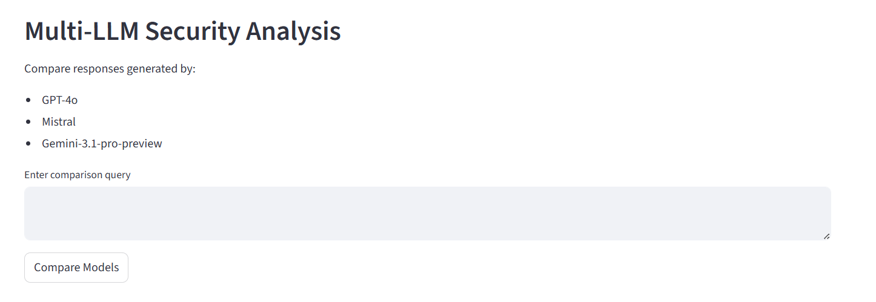
Streamlit App
6
Notes:
6

Slide 7
Topics of Discussion
7
Retrieval Evaluation – Did the system retrieve the correct requirements. (Precision@k, recall@k, MRR).
Similarity score with human validation accuracy.
How this app will be helpful for organizations solving compliance issues?
Notes:
7

Slide 8
8
Thank you
Notes:
8

